Slide 1

Nigeria Immigration Service (NIS)
Contactless Passport Application –Practical Steps

Slide 2

Contactless Passport Application
Purpose & Context
The contactless renewal pathway lets eligible Nigerians renew their passports without visiting a passport office for biometrics. It was launched on 1 November 2024 by the Honourable Minister of Interior and the Comptroller-General of Immigration as part of NIS’ wider digital-service drive.

Slide 3
Contactless Passport Application
The Mobile App was upgraded on 7th May, 2026 to enable it more user’s friendly.
Eligibility & Key Benefits
Eligible:
• Renewal cases only
• Passport with less than one year validity
• Adults 18 years and above
• Previously captured biometrics
• Owns a smart device with ICAO-grade camera
Not Eligible:
• Minors less than 18 years
• Fresh / lost / COD cases
• Finger-print bypass on last passport

Slide 4
Contactless Passport Application
Why It Matters:
24 / 7 self-service,
Faster processing
Real-time updates
No travel cost/risk

Slide 5
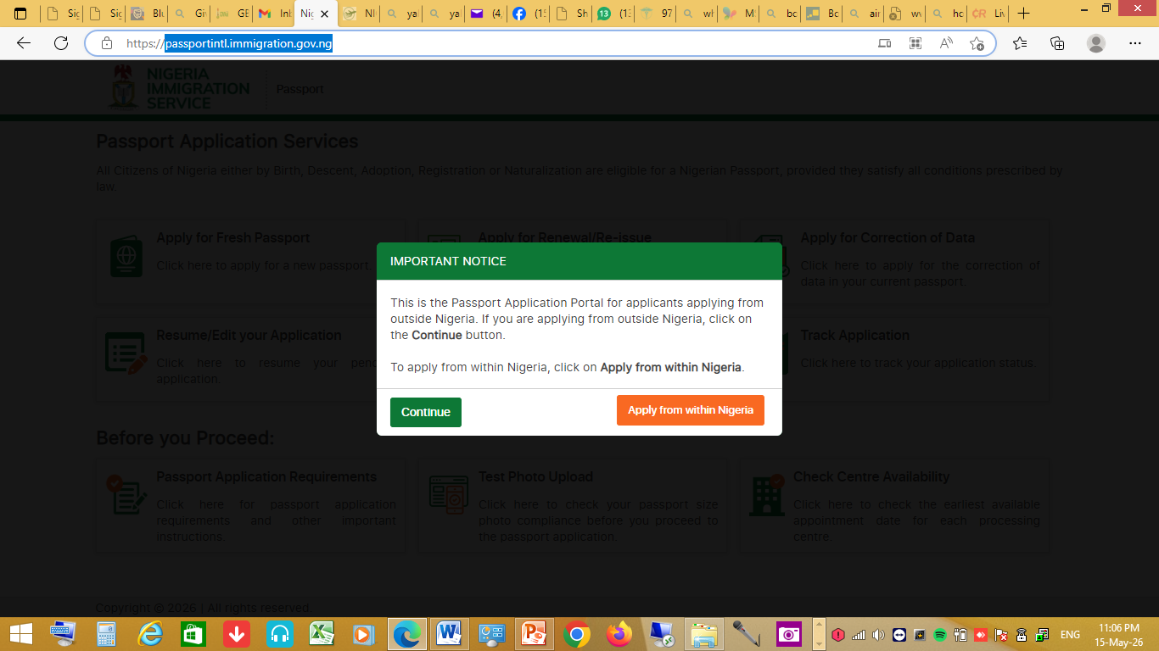
Passport Portal Navigation
Step 1
Type https://passportintl.immigration.gov.ng on your browser, click ‘continue’

Slide 6
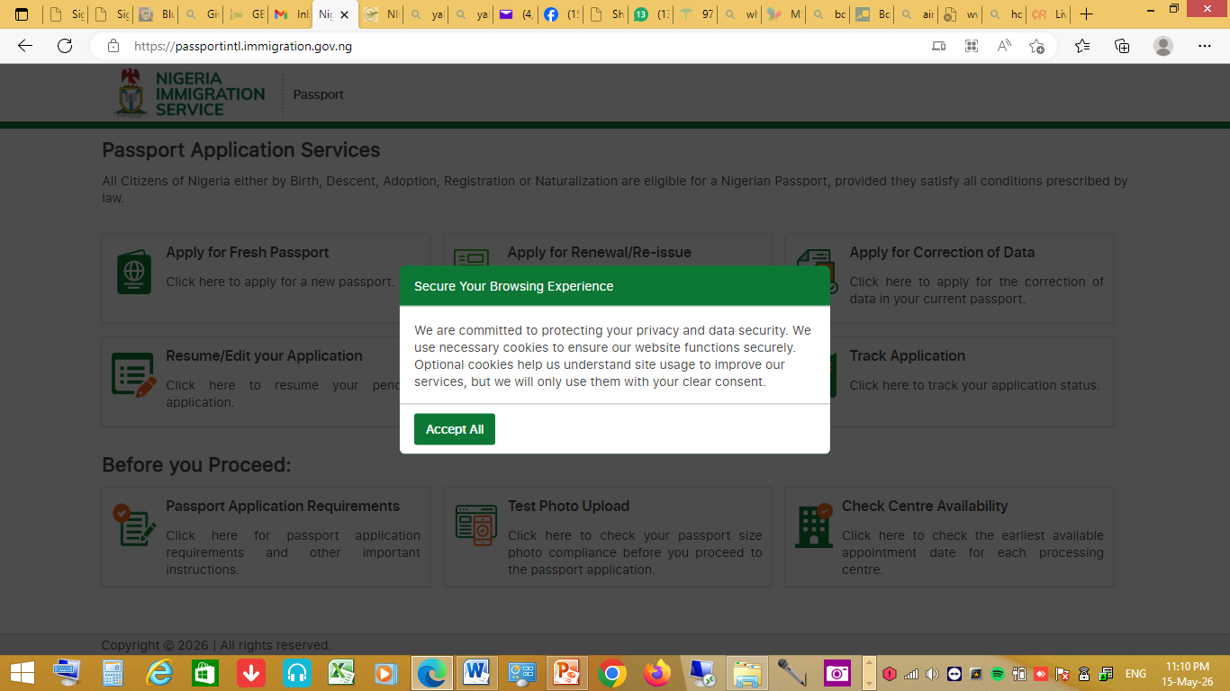
Passport Portal Navigation
Step 2
Click “Continue” as shown above, read the notes below and click “Accept All”

Slide 7
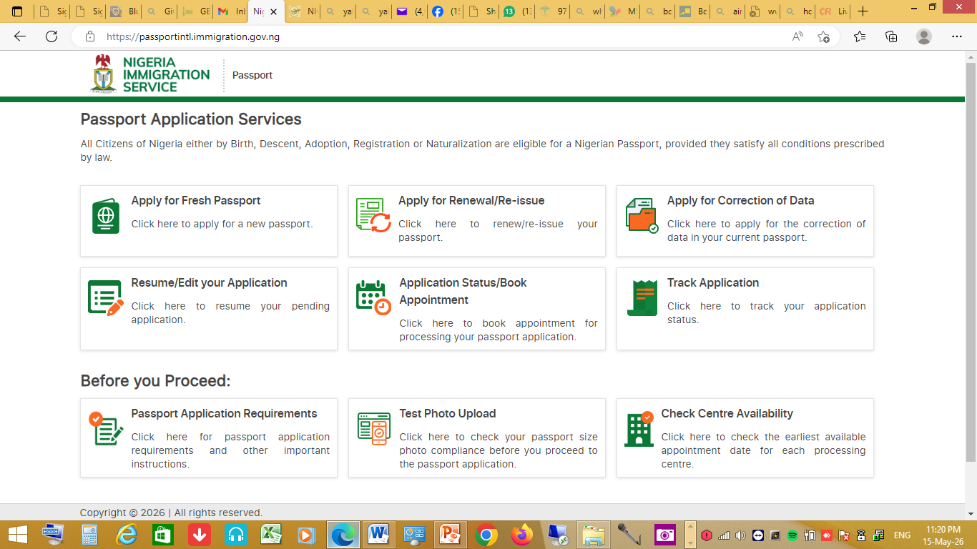
Passport Portal Navigation
Step 3 For the purpose of Contactless and its eligible applicant, select ‘Apply for Renewal/Re-issue’

Slide 8
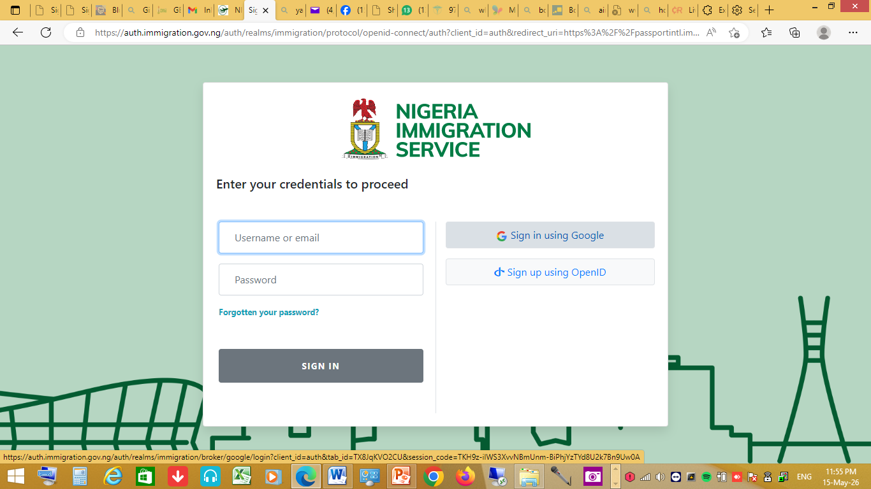
Passport Portal Navigation
Step 4
Click ‘Sign in using Google’ as shown below:

Slide 9
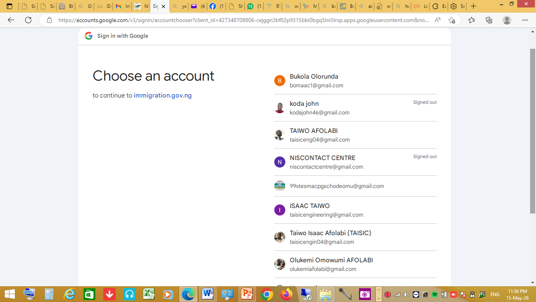
Passport Portal Navigation
Step 5 Select your google account from the list as shown below;

Slide 10
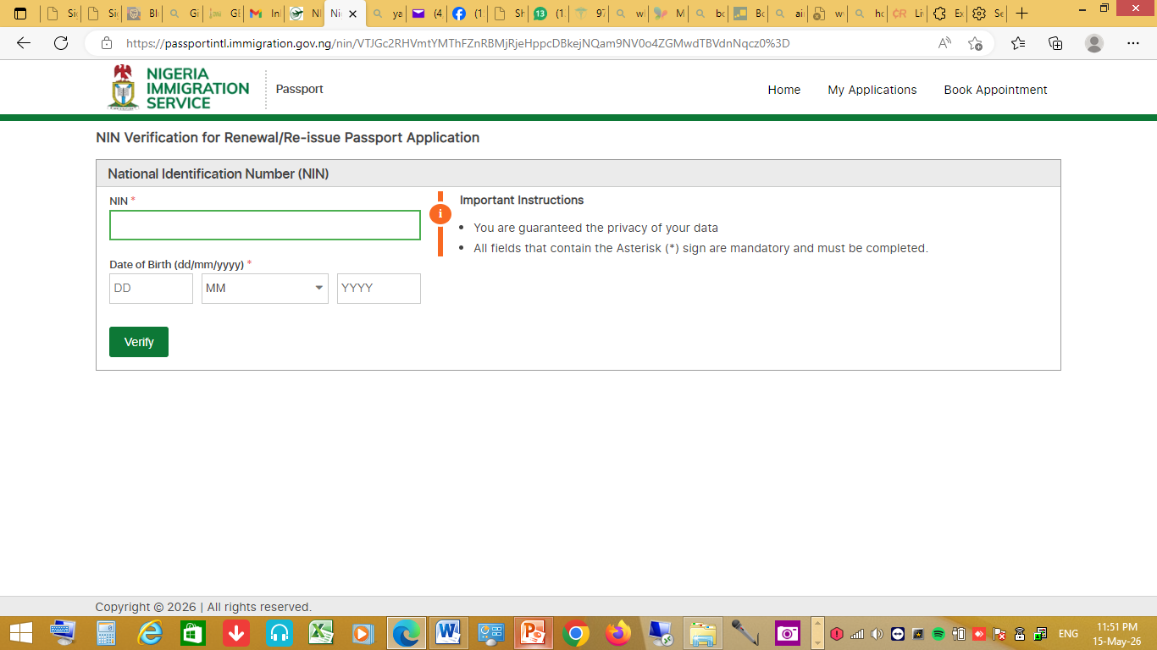
Passport Portal Navigation
Step 6
Enter your “NIN & DOB” and click ‘Verify’ as shown below;

Slide 11
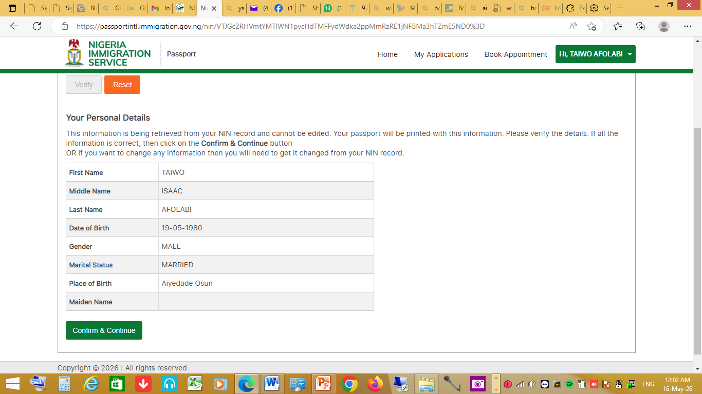
Passport Portal Navigation
Step 7, Your personal details appear as shown below: click ‘confirm & continue’ to proceed

Slide 12
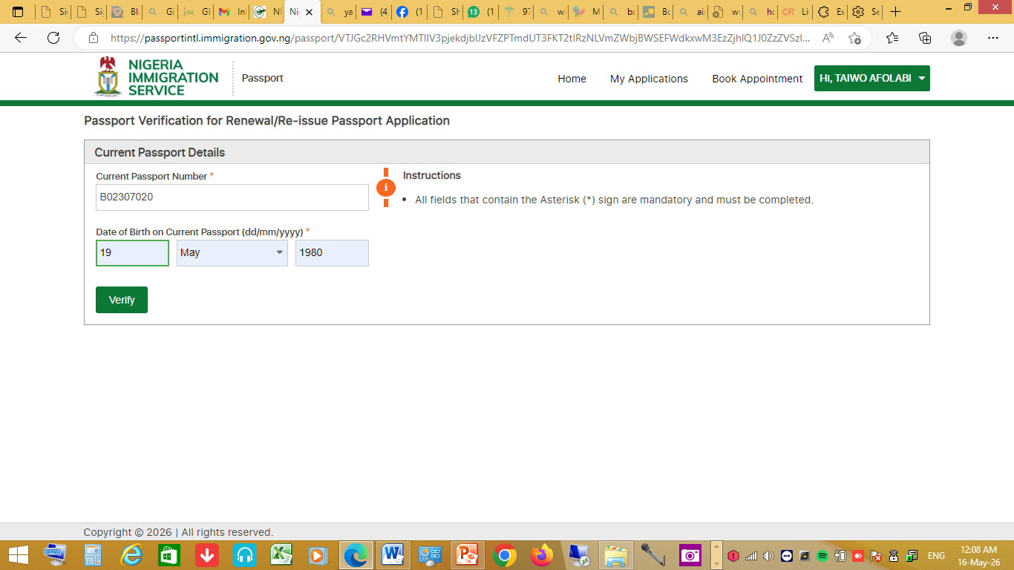
Passport Portal Navigation
Step 8 Enter your passport’s details and click ‘verify’ as shown below;

Slide 13
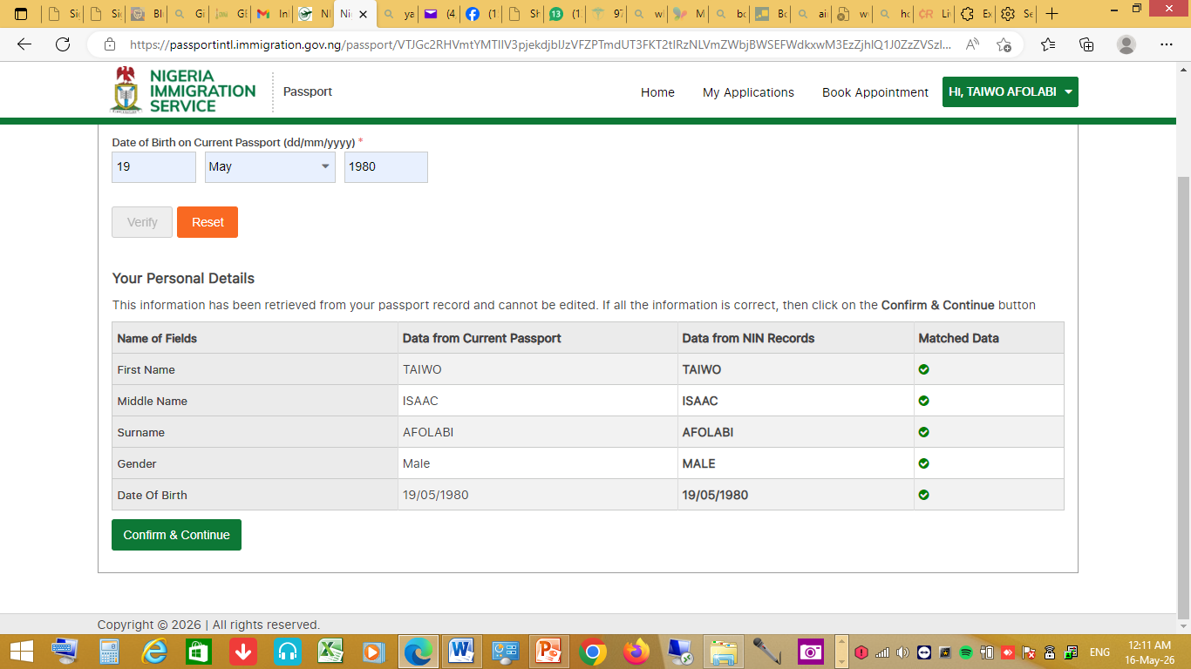
Passport Portal Navigation
Step 9 Both your NIN & Passport’s details are compared as shown below; click ‘confirm & continue’ provided all details on the NIN and the passport match

Slide 14
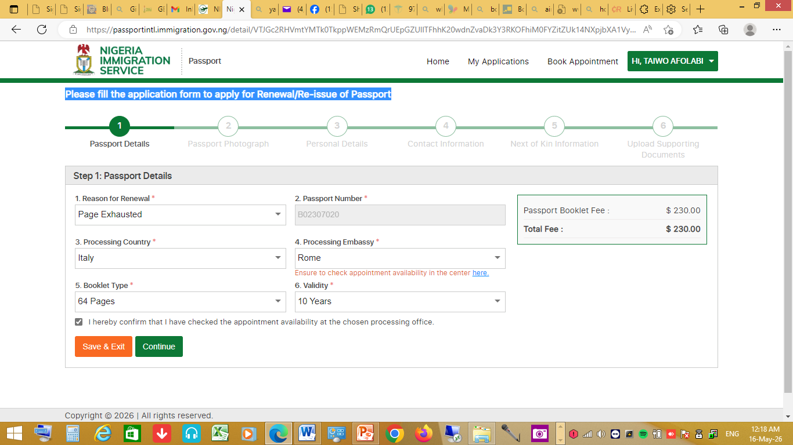
Passport Portal Navigation
Step 10 Please fill the application form to apply for Renewal/Re-issue of Passport as shown below; then, click ‘continue’

Slide 15
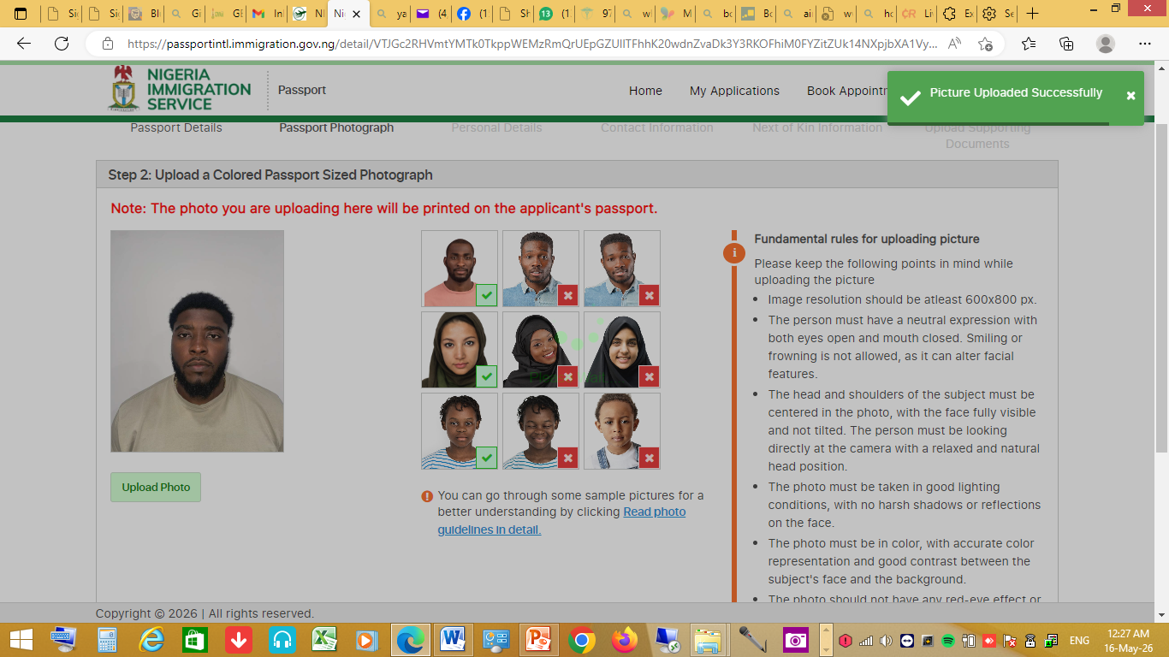
Passport Portal Navigation
Step 11. Upload an ICAO’s standard passport size photograph and click ‘continue’

Slide 16
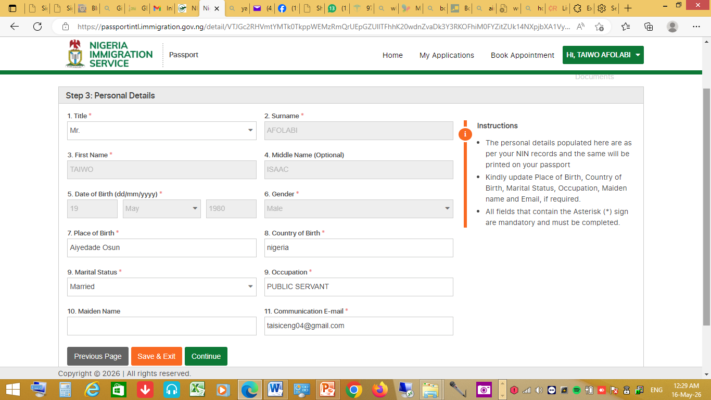
Passport Portal Navigation
Step 12. Confirm your details as shown and click ‘continue’

Slide 17
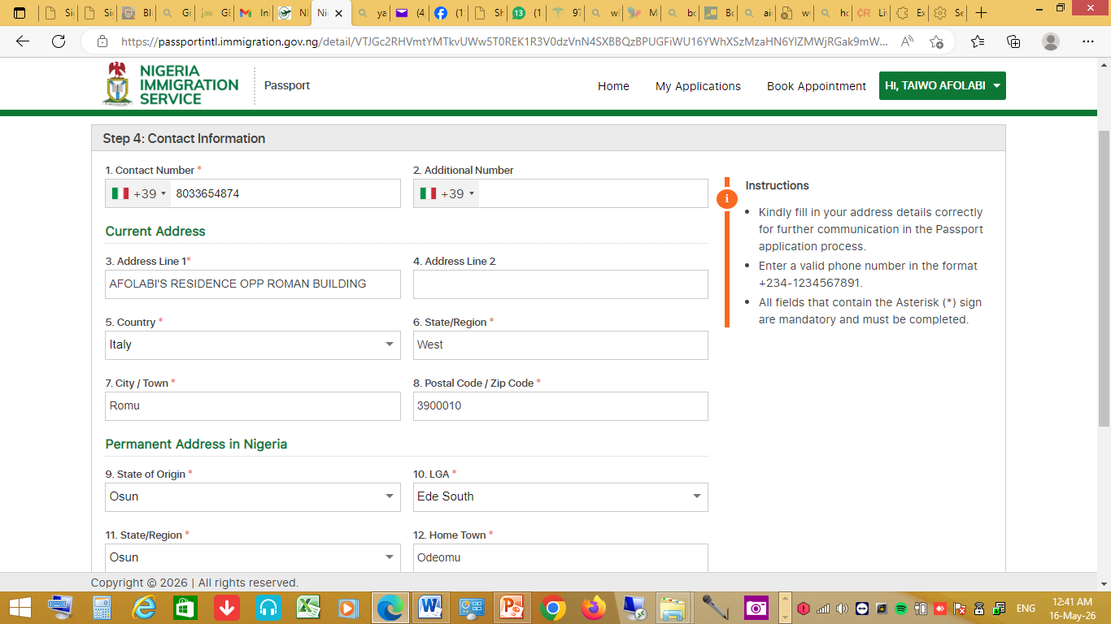
Passport Portal Navigation
Step 13. Fill in your contact information as shown below and click ‘continue’

Slide 18
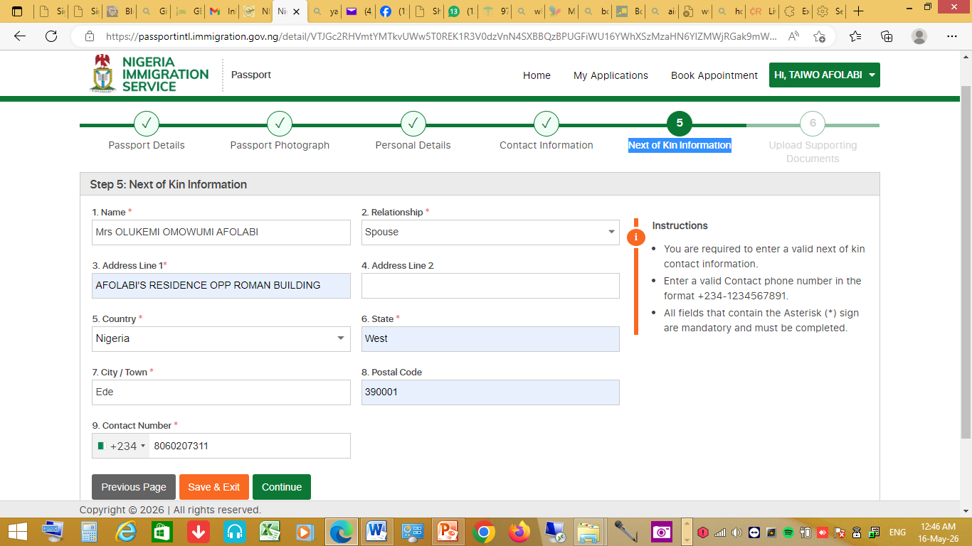
Passport Portal Navigation
Step 14. Fill your next of kin’s details as shown below and click ‘continue’

Slide 19
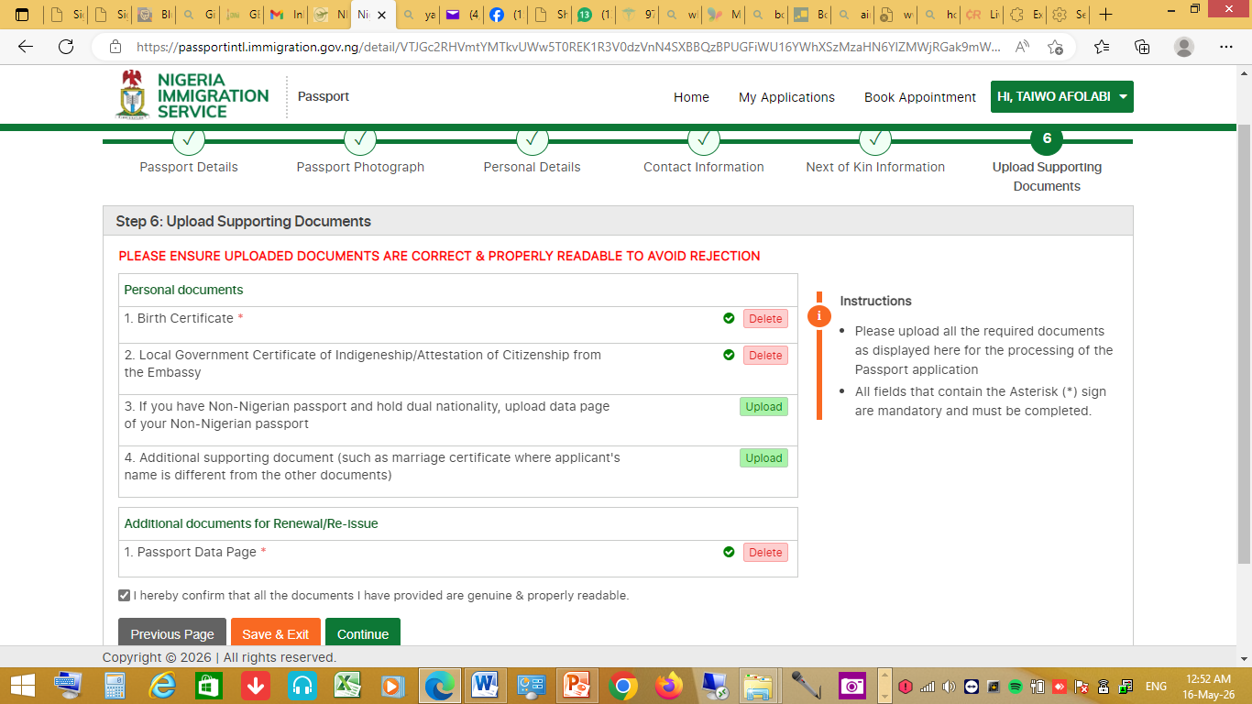
Passport Portal Navigation
Step 15. Upload all the supporting documents, tick the check box and click ‘continue’ as shown below;

Slide 20
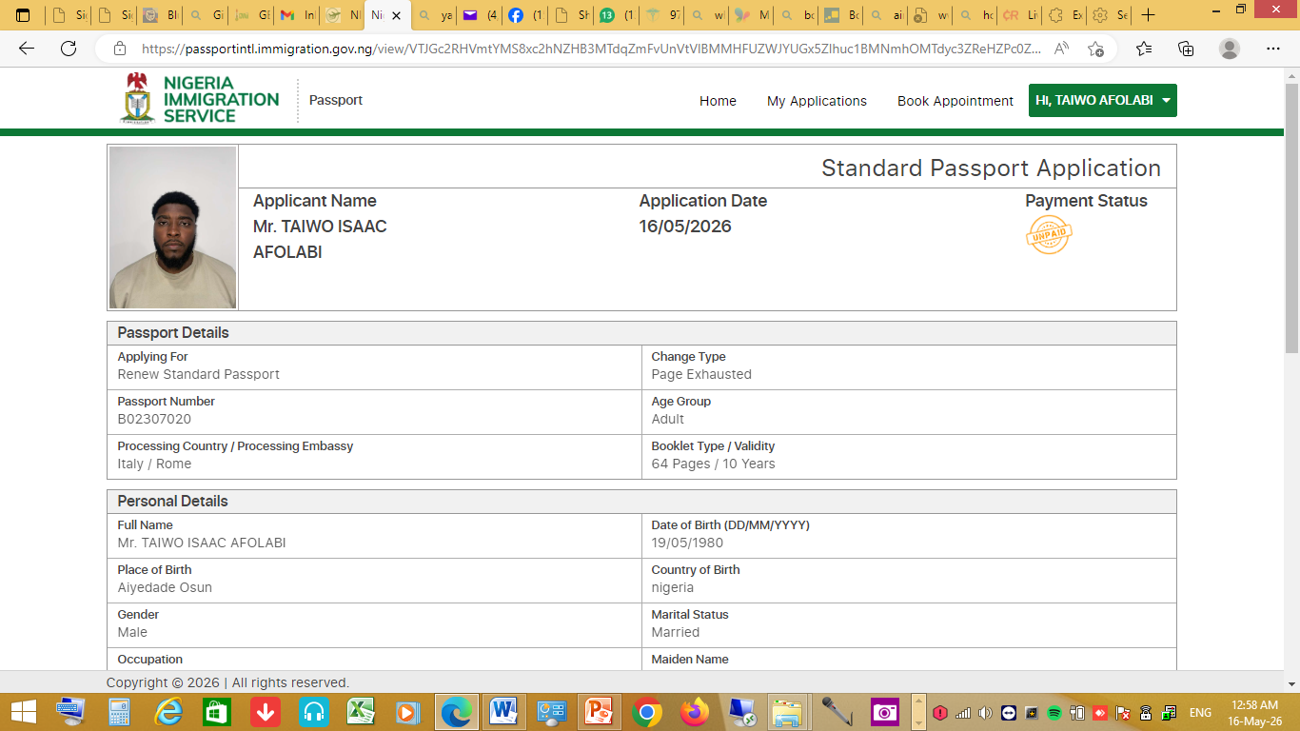
Passport Portal Navigation
View your details on the form before submission.

Slide 21
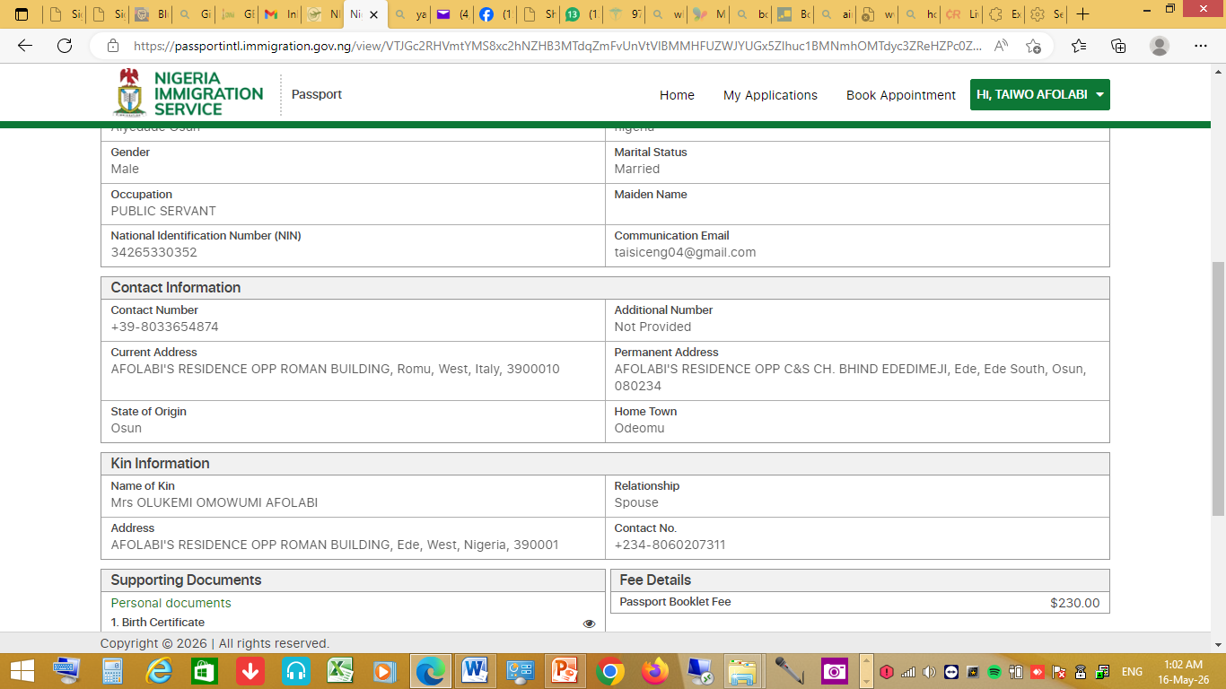
Passport Portal Navigation
View your details on the form before submission.

Slide 22
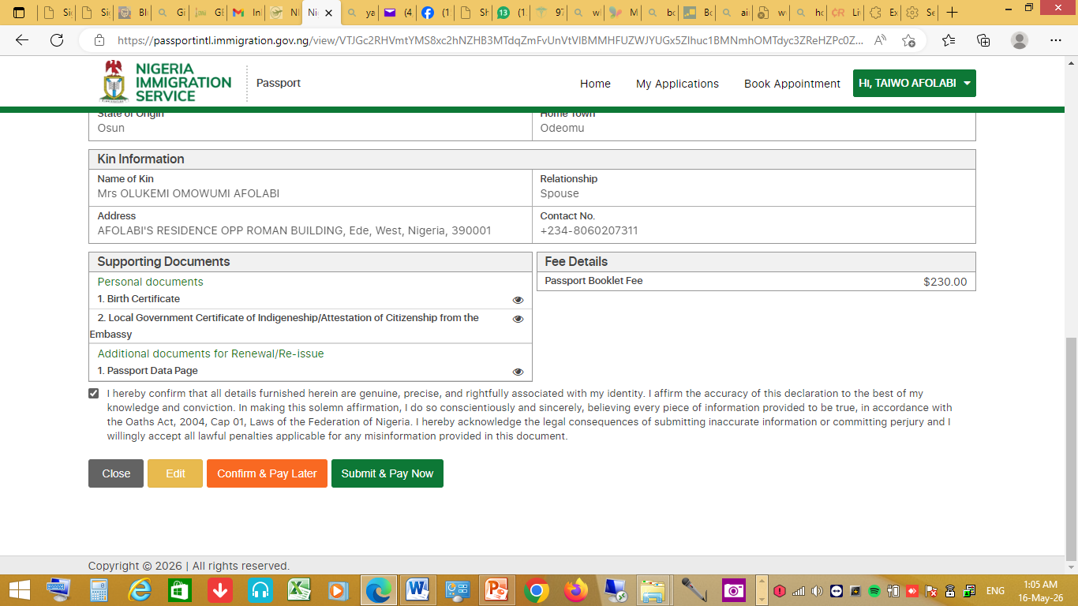
Passport Portal Navigation
View your details on the form before submission, then click either ‘submit & pay later’ of ‘submit & pay now’

Slide 23
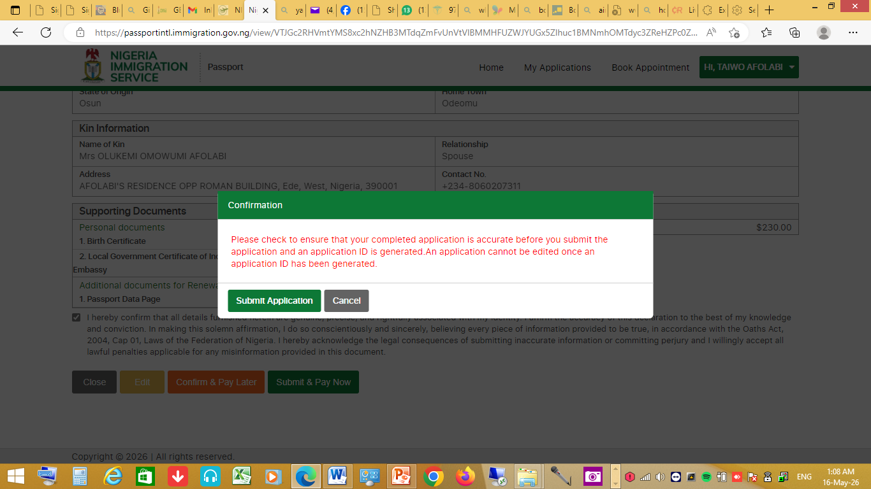
Passport Portal Navigation
Step 16. Read the note below carefully; then click ‘Submit Application’

Slide 24
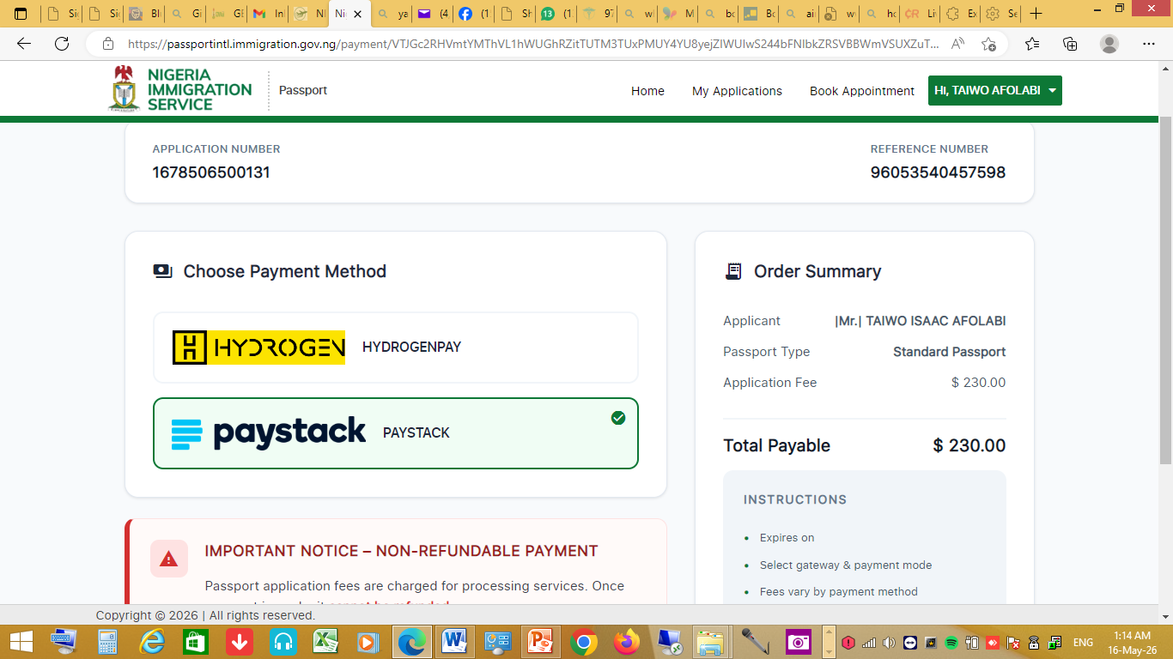
Passport Portal Navigation
Step 17. Select your choice payment gateway and pay as show below;

Slide 25
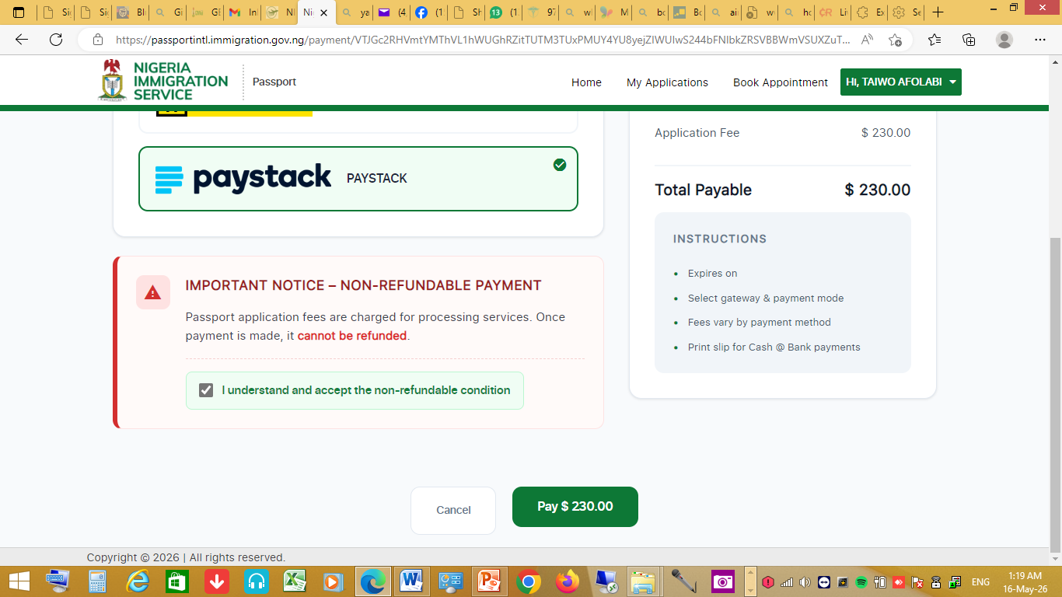
Passport Portal Navigation
Select your choice payment gateway, read the ‘important notice’ and pay as show below;

Slide 26
Contactless Passport Application
Contactless Passport Application
PRACTICAL STEPS
MAY, 2026

Slide 27
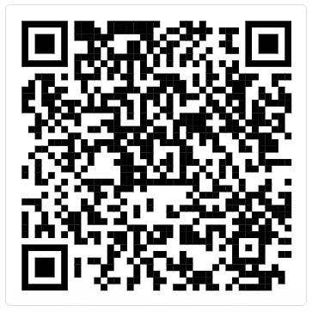
Contactless Passport Application
Getting Started
Install NIS Mobile App from Google Play (App Store release forthcoming).
URL: https://play.google.com/store/apps/details?id=com.irissmart.nismobile
Scan to download app →
2. Launch the app → tap Get Started → Create Profile → complete registration & verify email OTP.

Slide 28
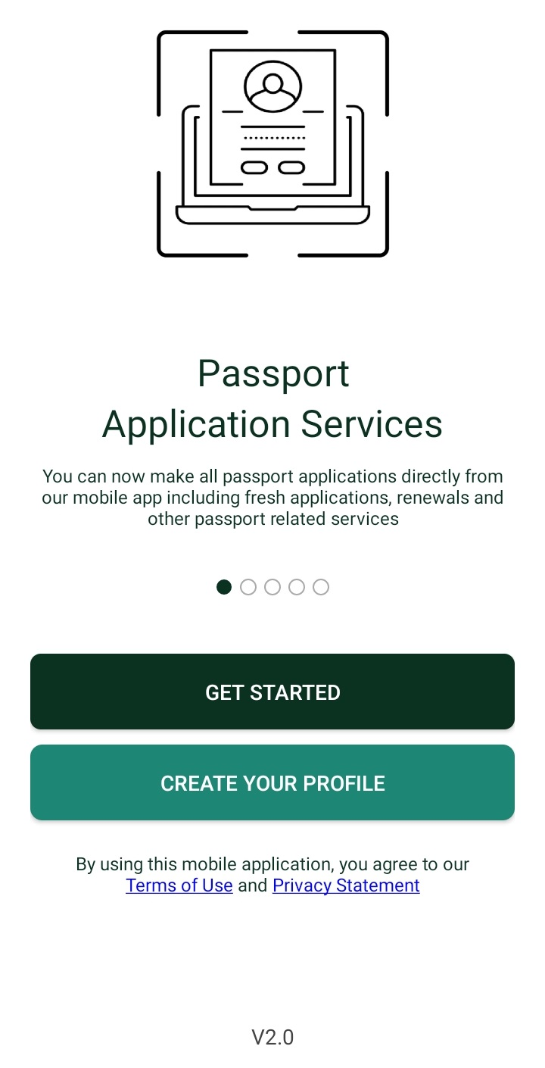
Contactless Passport Application
Sign in and land on the Applicant Dashboard
.

Slide 29
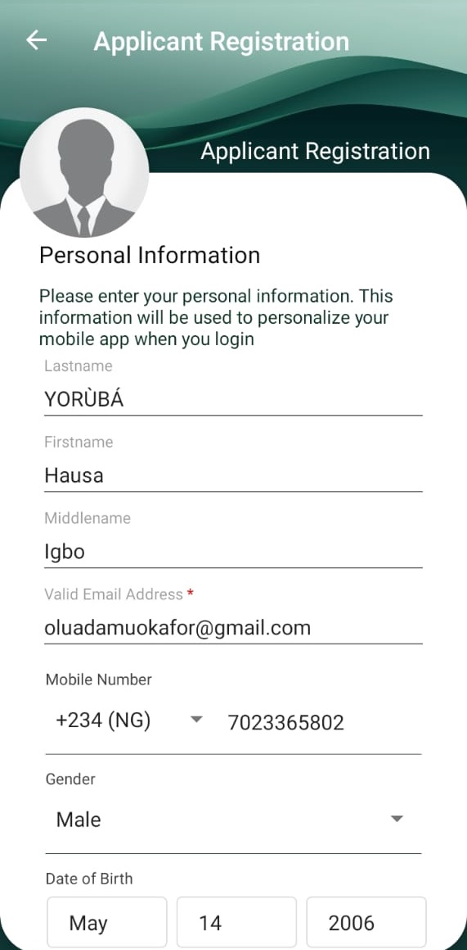
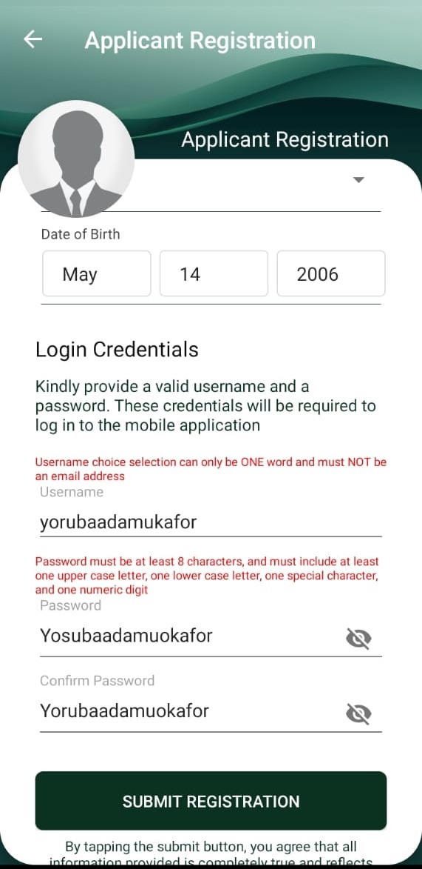
Contactless Passport Application
Create a profile
1 2

Slide 30

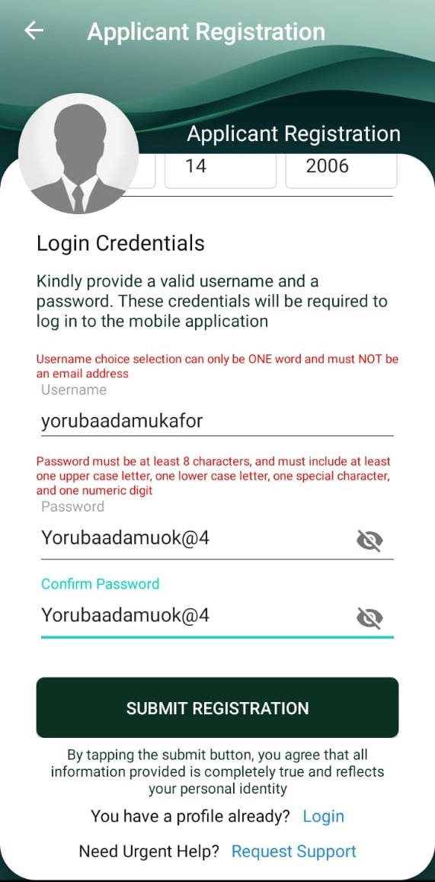
Contactless Passport Application
Create a profile
{Password is case sensitive & has a format} Password’s format required

Slide 31
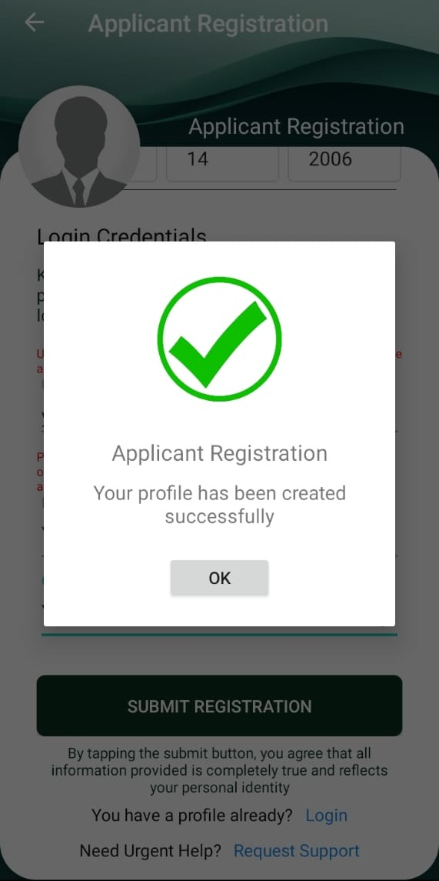
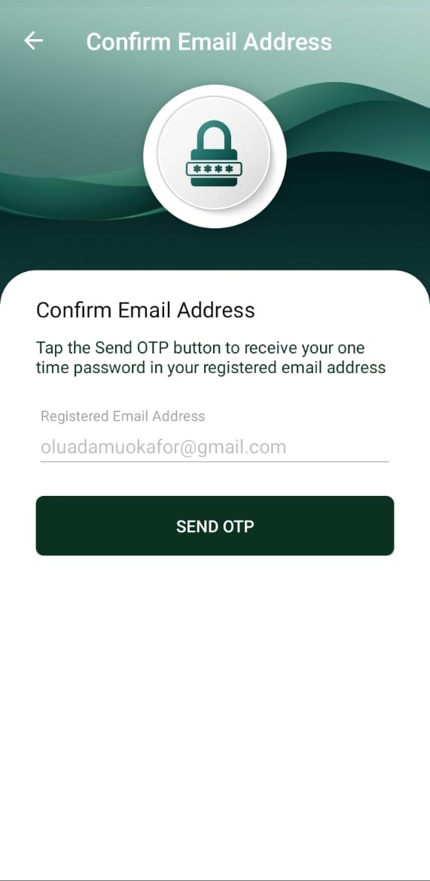
Contactless Passport Application
Create a profile
Successful Confirm with OTP sent to your e-mail box

Slide 32
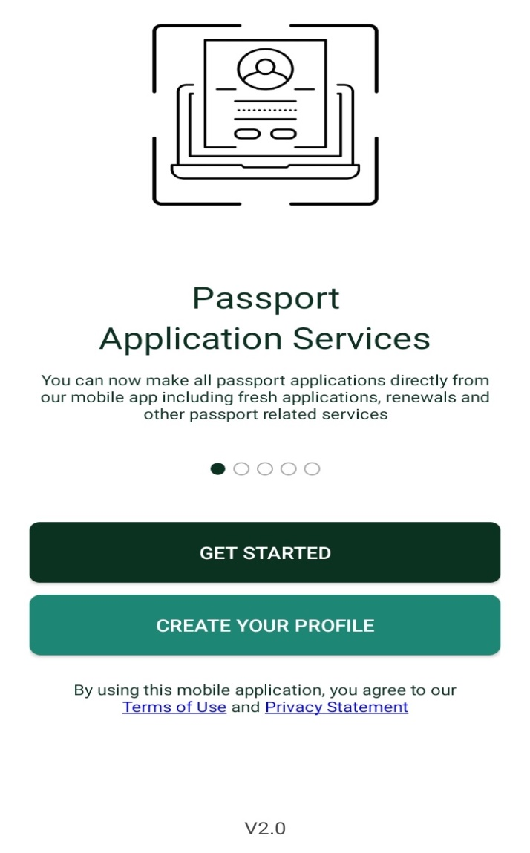
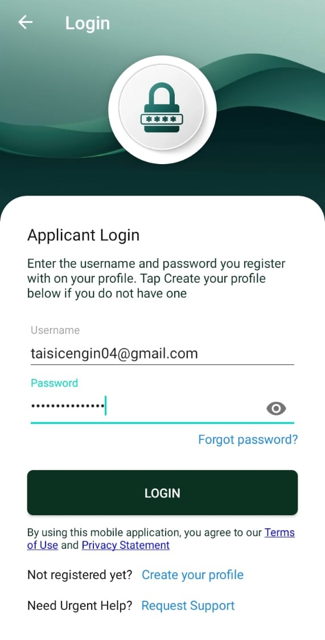
Contactless Passport Application
Get Started.
Click ‘GET STARTED’ as shown below Type in your credentials and login

Slide 33
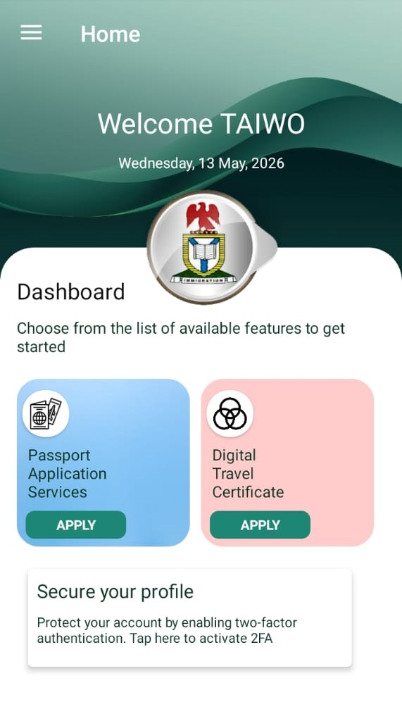
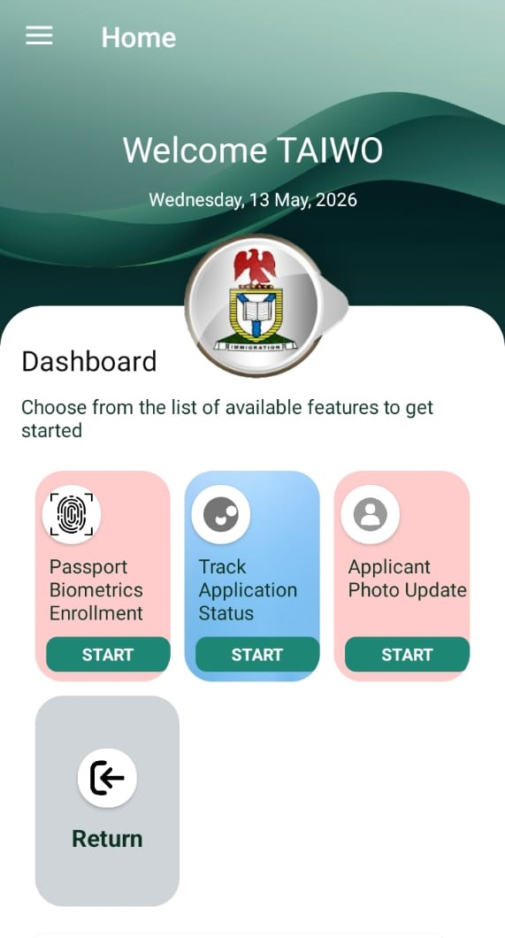
Contactless Passport Application
Successfully Logged-in
Page 1 Page 2

Slide 34
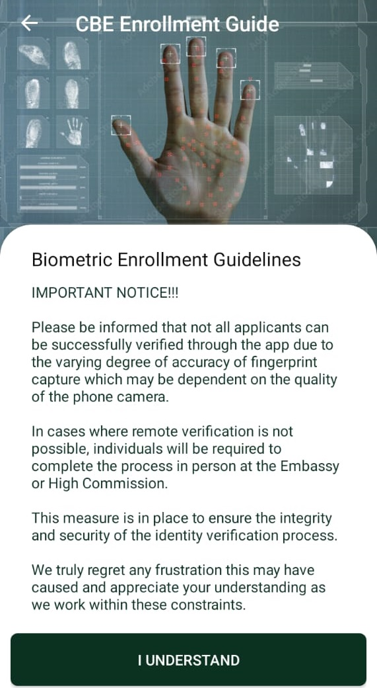
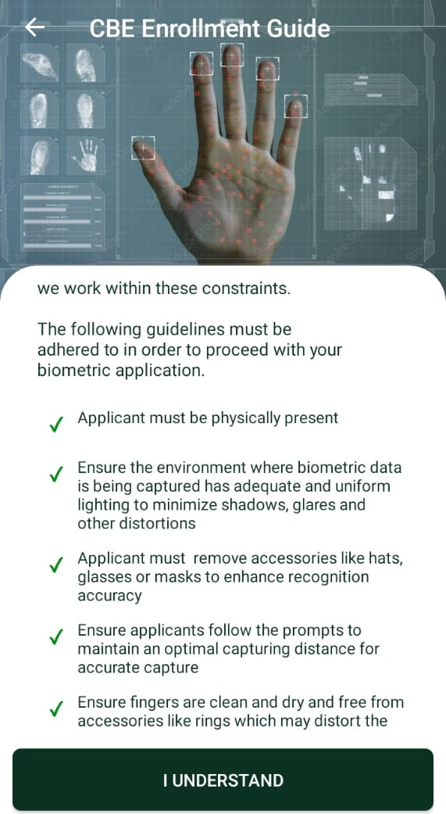
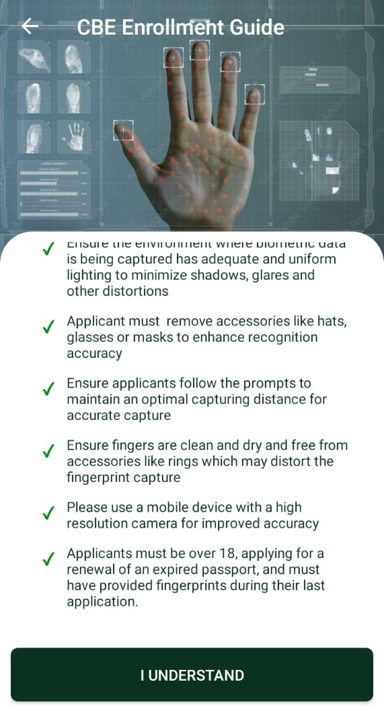
Contactless Passport Application
Click ‘I UNDERSTAND’ to proceed
2 3

Slide 35
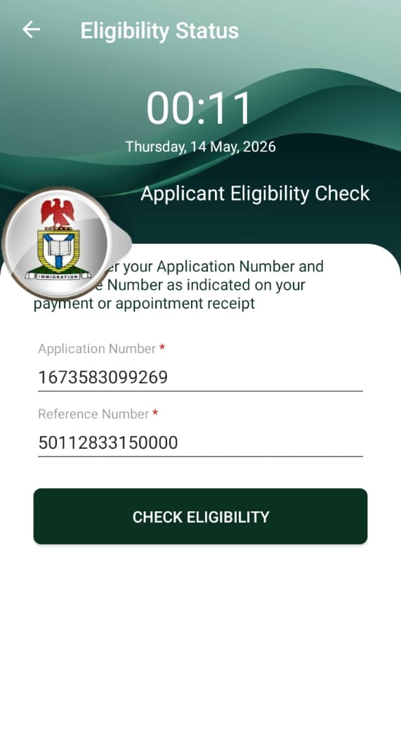
Contactless Passport Application
Eligibility Checks; input both your reference and application IDs as shown below:

Slide 36
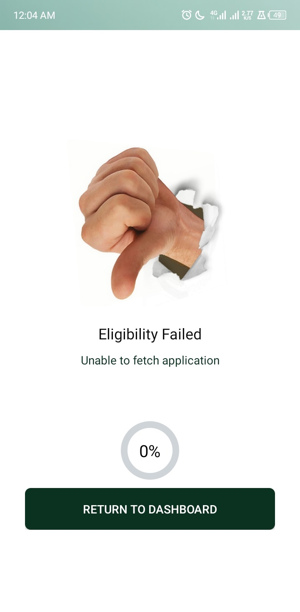

Contactless Passport Application
Two Possible Eligibility Check’s Results
Failed ELIGIBLE
Proceed for your biometrics

Slide 37
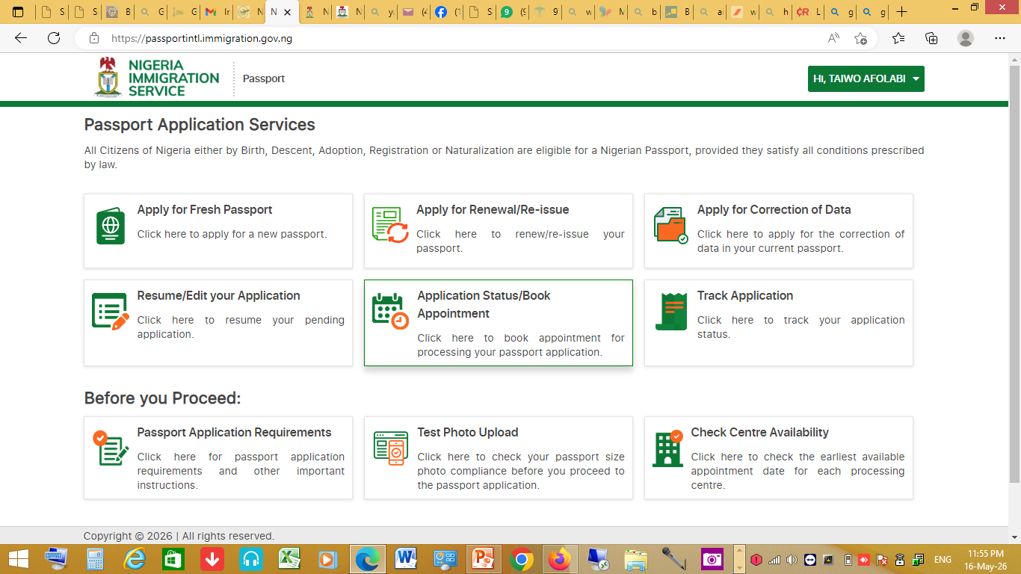
Contactless Passport Application
To either book an appointment or opt-in for contactless, click ‘Home’ and select ‘Appointment Status/Book Appointment’ as shown below;

Slide 38
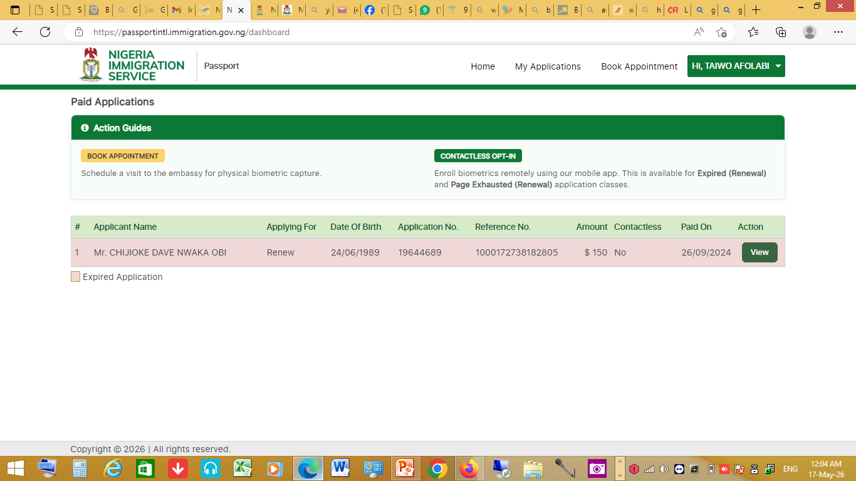
Contactless Passport Application
Select either ‘Book Appointment’ or “Contactless Opt-in” as it applies to you with the Eligibility Checks’ result as shown below;

Slide 39
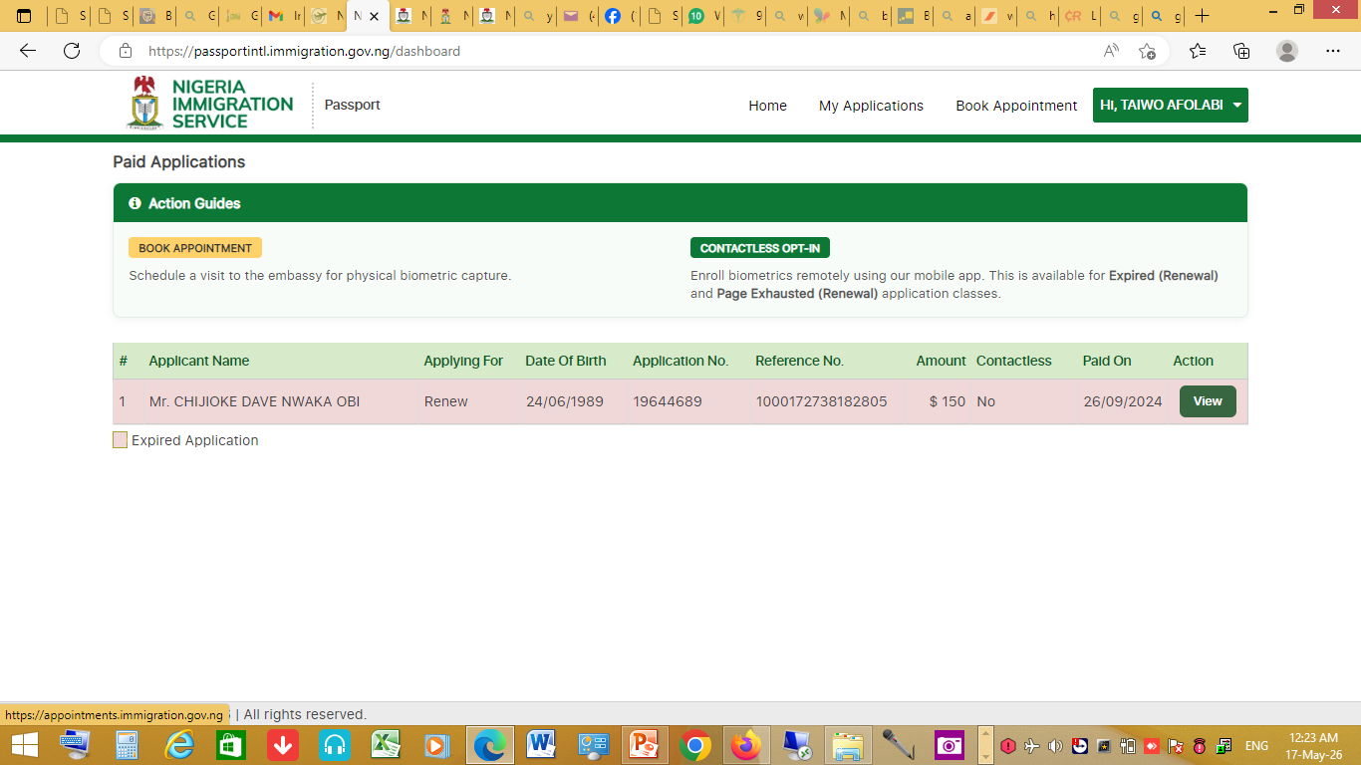
Book An Appointment
Click ‘Book Appointment’ at the top right corner of the page as shown below;

Slide 40
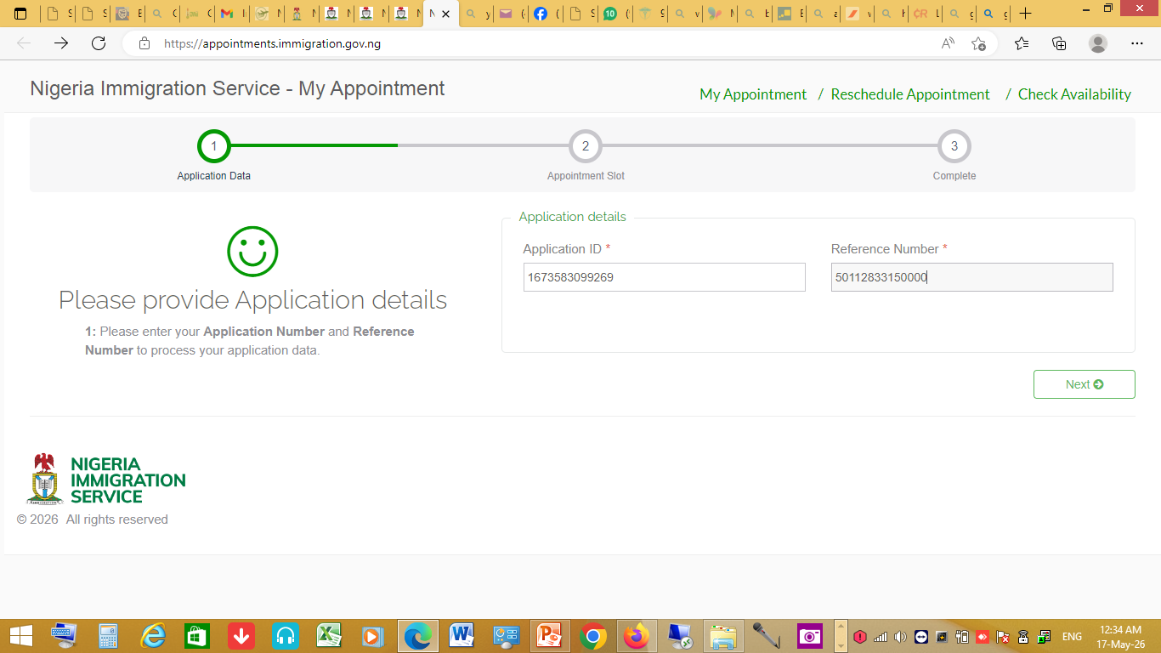
Book An Appointment
Input both your application ID & reference number and click ‘Next’ as shown below;

Slide 41
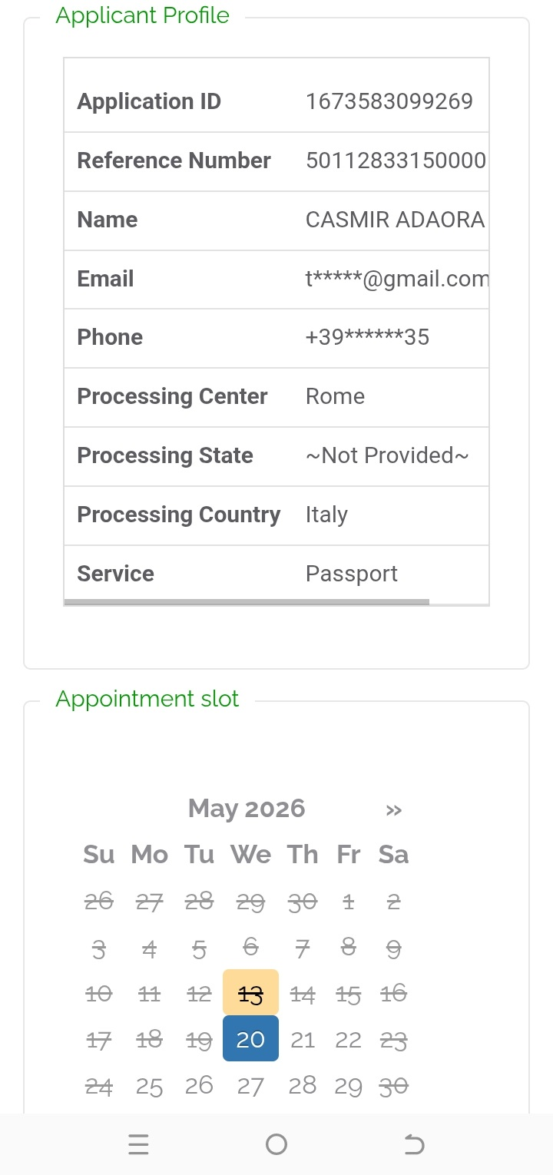
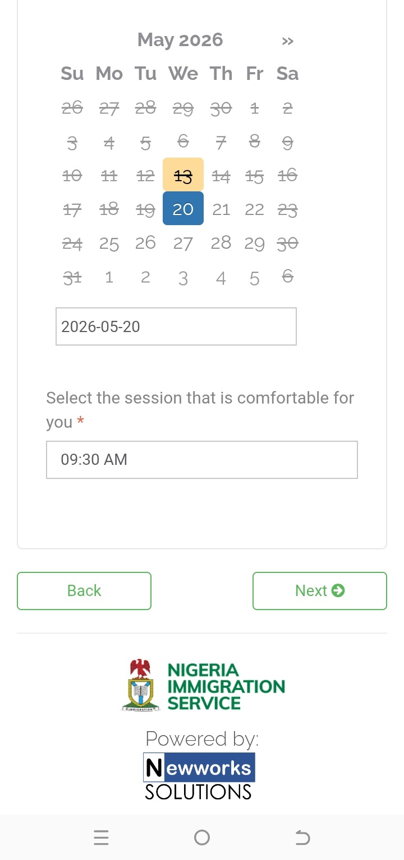
Book An Appointment
Select your preferred appointment date from the available date on the calendar and click ‘Next’ as shown below;

Slide 42
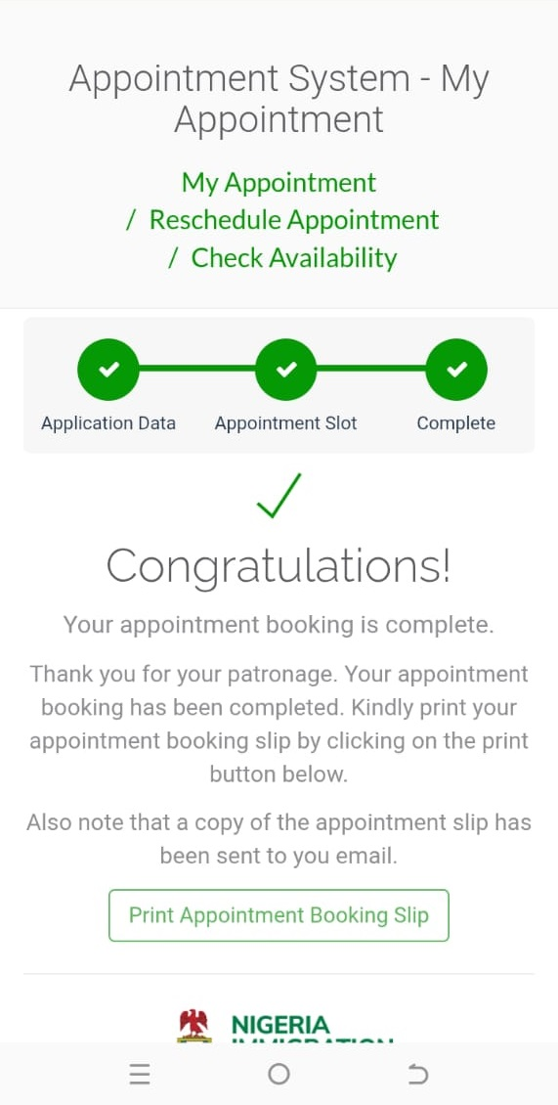
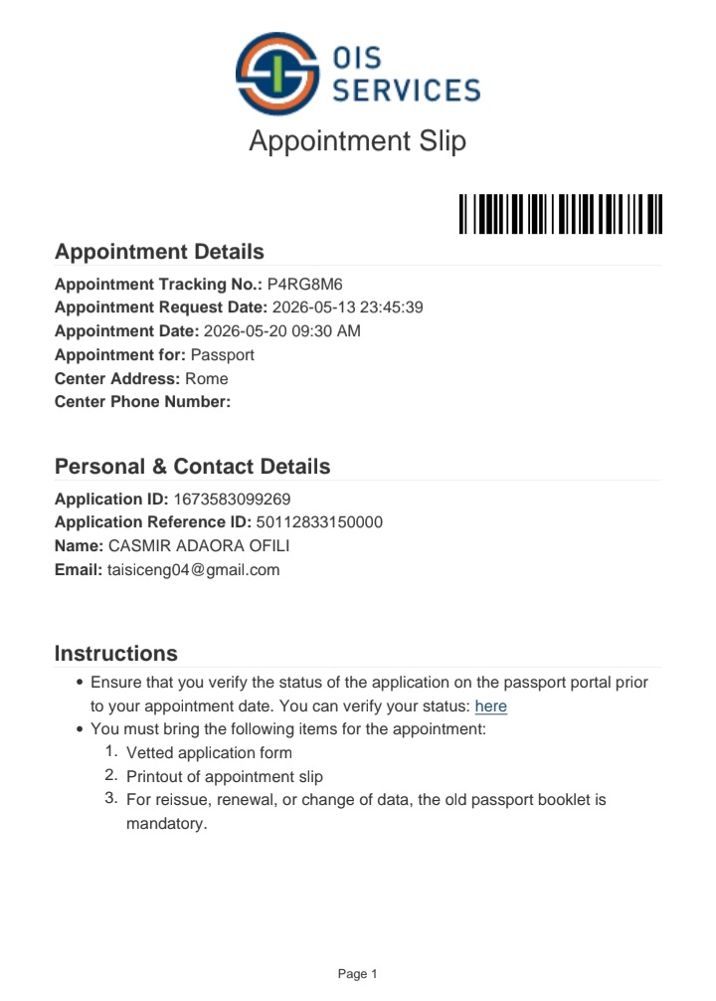
Book An Appointment
You have successfully booked an appointment as shown below; you may wish to print it. Appointment Slip

Slide 43
Contactless Passport Application
THANK YOU ALL

